Slide 1
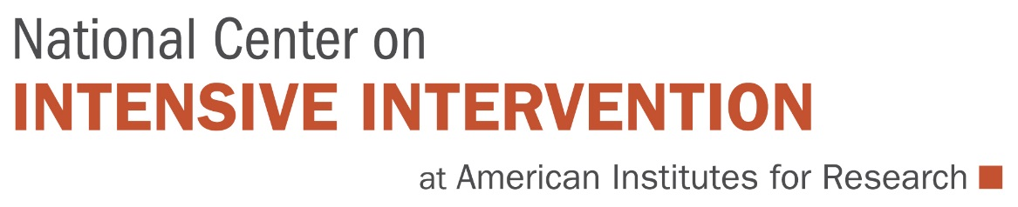

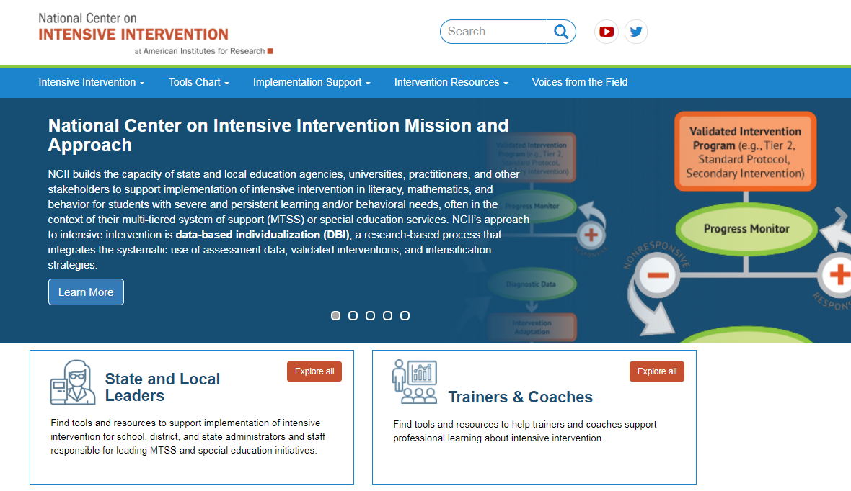
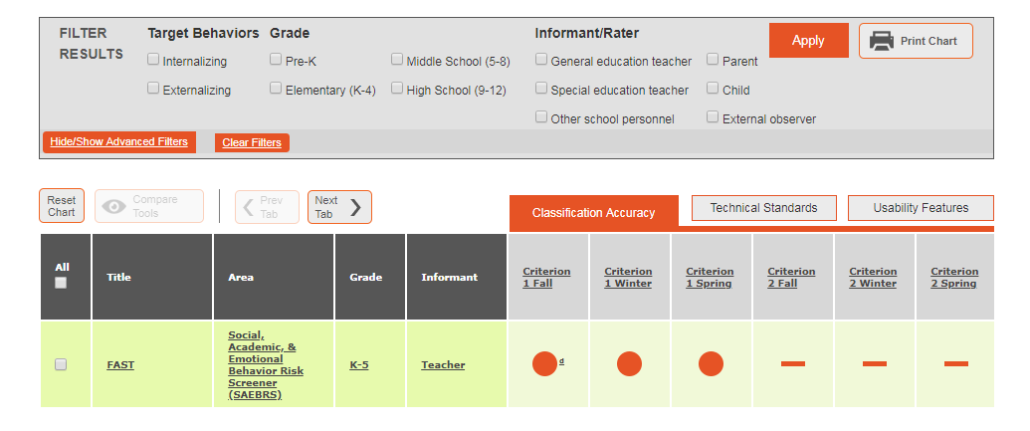
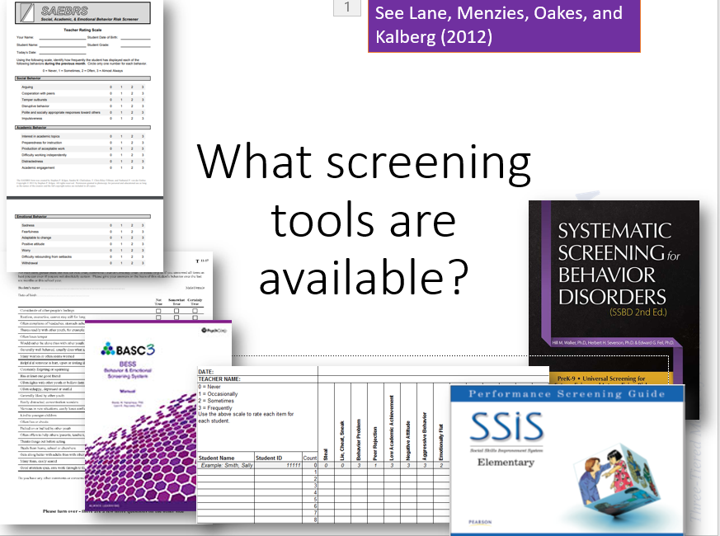
The Role of Behavior Screening in Tiered Systems of Support
Kathleen Lynne Lane, University of Kansas
Amy Peterson, National Center on Intensive Intervention
www.intensiveintervention.org

Slide 2


NCII & CEC’s Division for Research

Slide 3
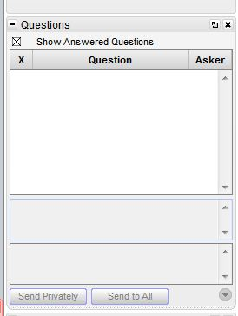
Webinar Format and Questions
Throughout the presentation, submit your questions
into the question pod.
  For technical issues and questions, a webinar team
  member will try to assist you as soon as possible.
  For content-related questions, there will be a time for
  Q&A at the end of the presentation. Submit your
  questions and we will share them with the presenters.

Slide 4


Moderator and Presenter
Kathleen Lynne Lane, is a professor in the Department of Education at The University of Kansas.
Amy Peterson, coordinator for communications and collaboration for the National Center on Intensive Intervention at American Institutes for Research

Slide 5
Today’s Webinar
Provide an overview of the logistics for systematic behavior screening
Introduce the NCII’s Behavior Screening Tools Chart

Slide 6
Systematic Screening:
An Overview of the Logistics

Slide 7
Thank you…
For Your Commitment
Students with emotional and behavioral disorders (EBD) represent a diverse and challenging group of students to teach (Forness, Freeman, Paparella, Kauffman, & Walker, 2011)
Historically as a field we have
  viewed behavioral and social challenges to be within individual deficits (Landrum & Tankersley, 2013)
  relied on reactive approaches to address these challenges (Horner & Sugai, 2015)
Internalizing
Externalizing
Shift to a systems level perspective
ED <1%
EBD 12-20%

Slide 8
Michael Yudin urged educators and educational system leaders to “pay as much attention to students’ social and behavioral needs as we do academics” …
2014 National PBIS Leadership Conference, Michael Yudin, Assistant Secretary for the Office of Special Education and Rehabilitation of the United States Department of Education

Slide 9
Comprehensive, Integrated, Three-Tiered Model of Prevention
Comprehensive, Integrated, Three-Tiered Model of Prevention
(Lane, Kalberg, & Menzies, 2009)
Goal: Reduce Harm
Specialized individual systems for students with high-risk
≈5%
Tertiary Prevention (Tier 3)
Goal: Reverse Harm
Specialized group systems
for students at-risk
≈15%
Secondary Prevention (Tier 2)
Goal: Prevent Harm
School/classroom-wide systems for all students, staff, & settings
PBIS Framework
≈80%
Validated Curricula
Primary Prevention (Tier 1)
Academic Behavioral Social

Slide 10
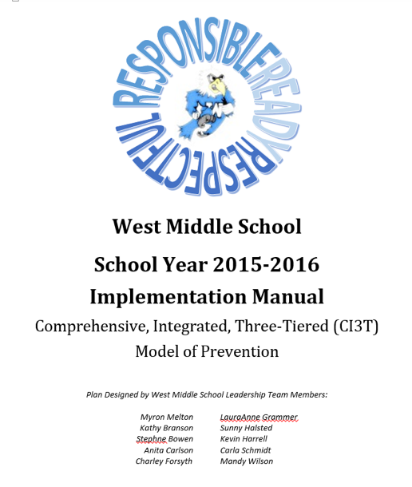
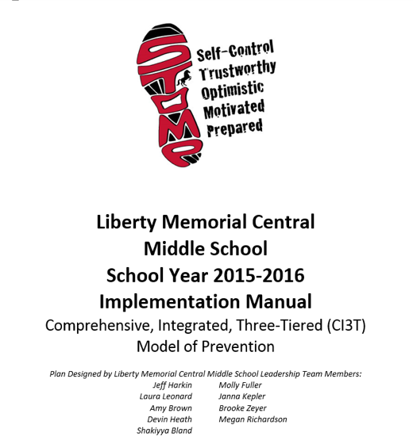
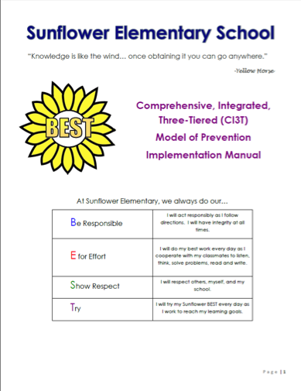
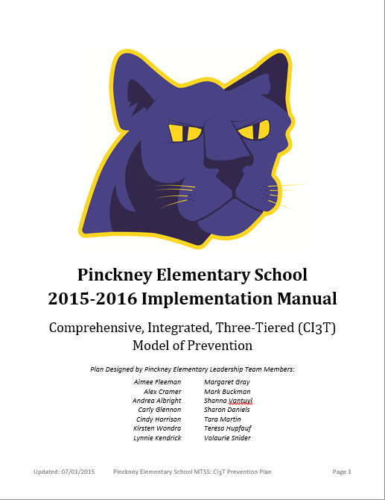
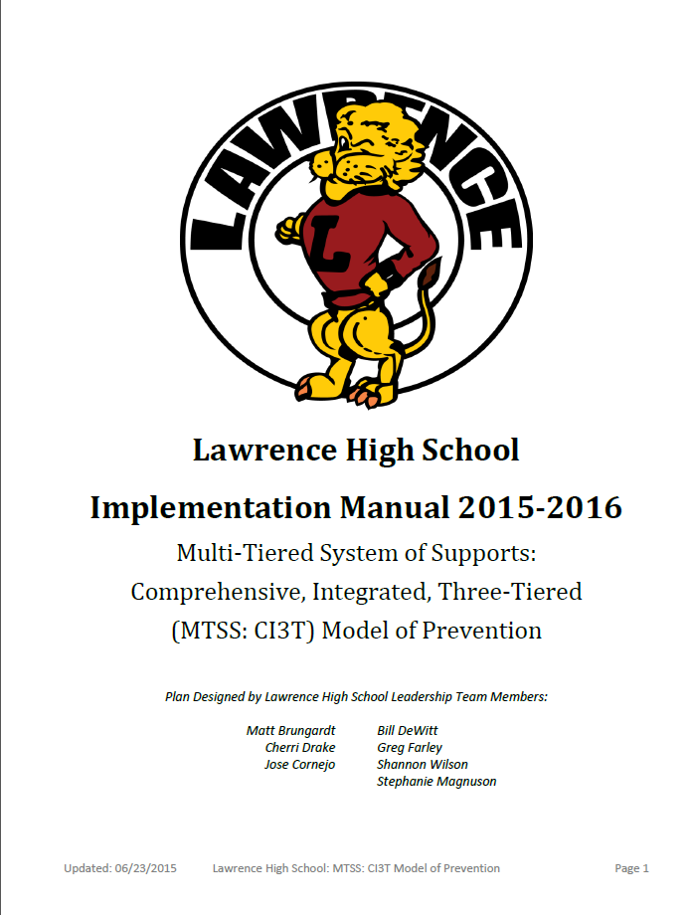
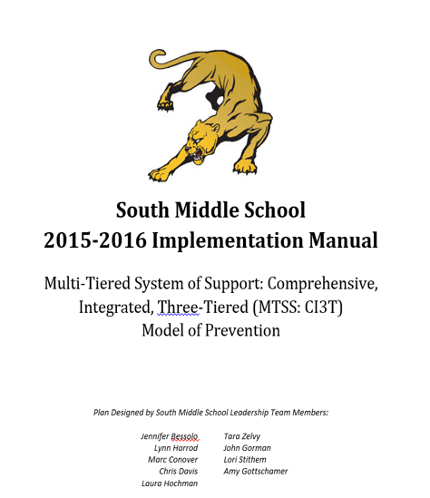

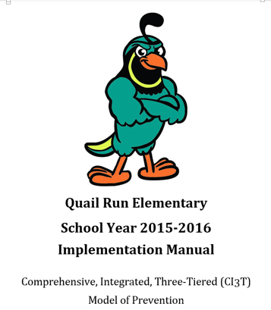
Materials

Slide 11
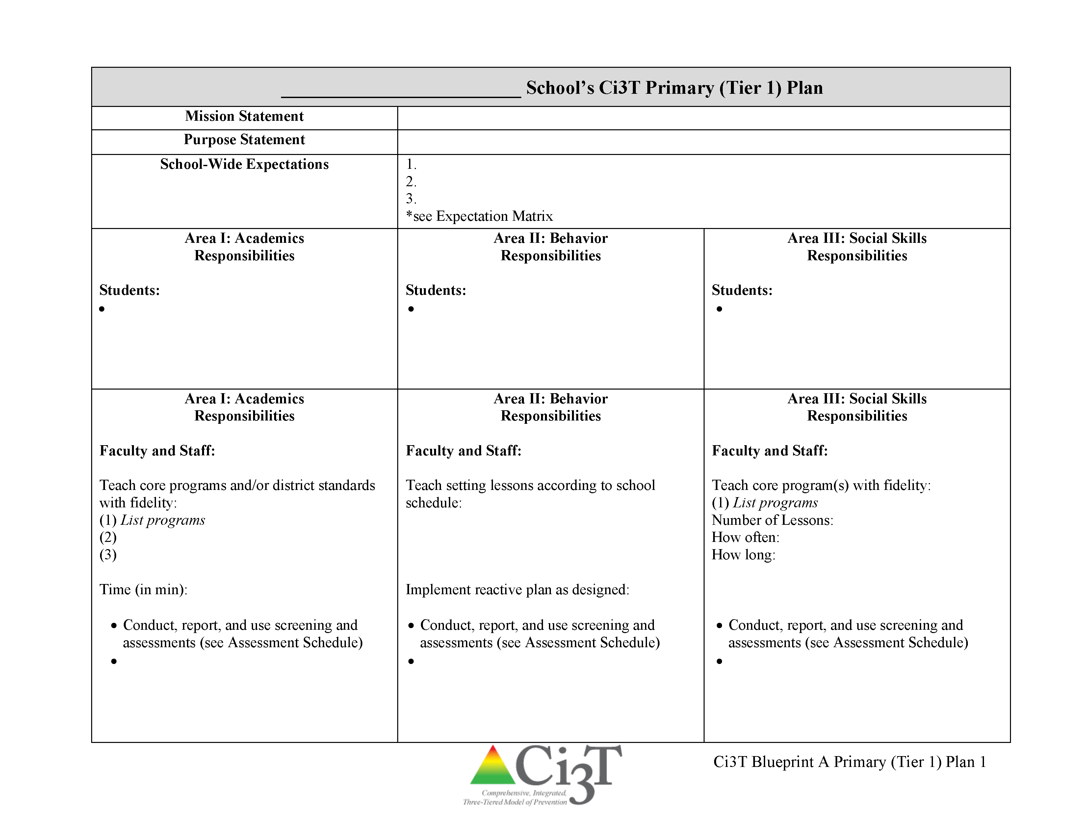
Ci3T Primary Plan: Roles and Responsibilities
all stakeholder groups

Slide 12
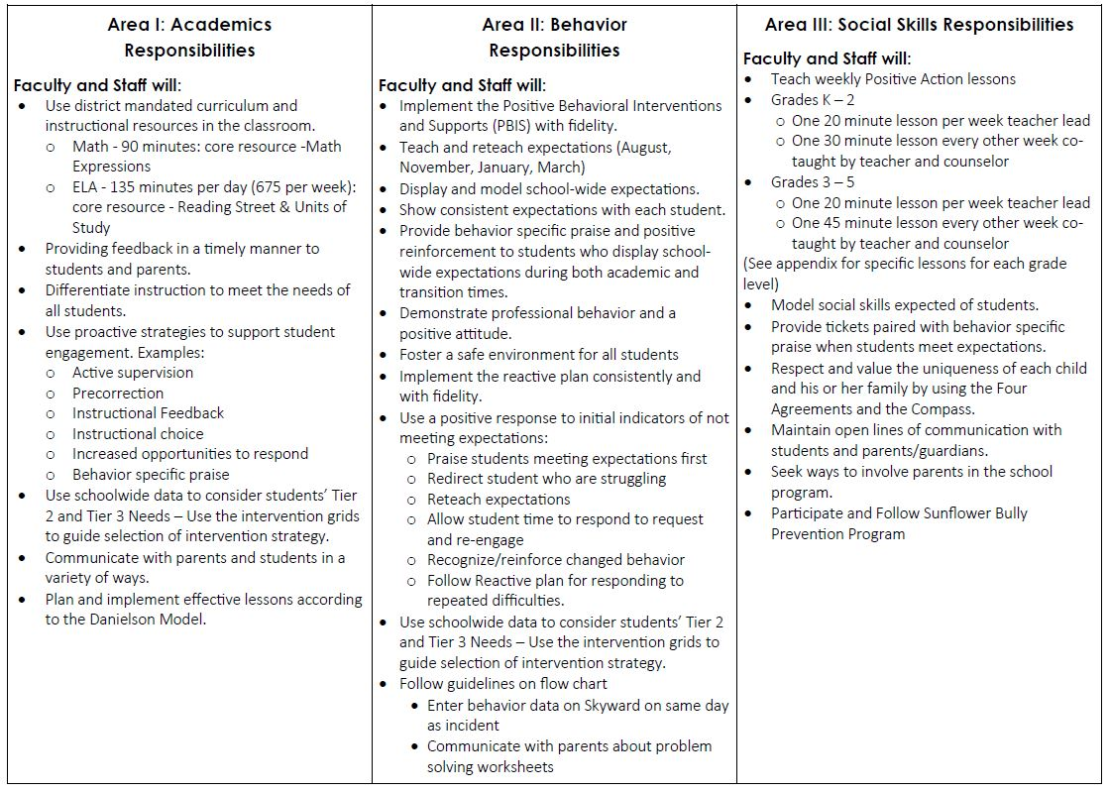
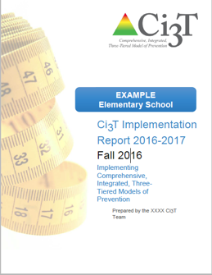
CI3T materials
Ci3T Primary Plan: Procedures for Teaching
Ci3T Primary Plan: Procedures for Reinforcing
Ci3T Primary Plan: Procedures for Monitoring

Slide 13
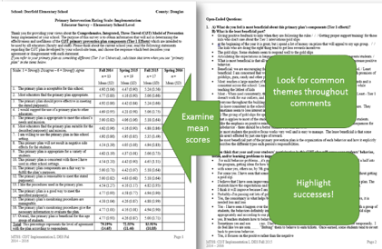

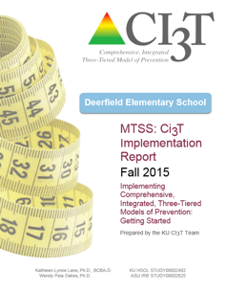
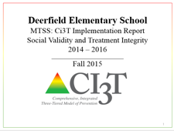
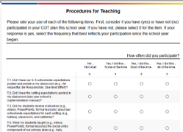
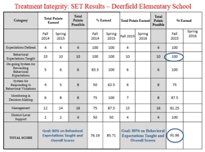


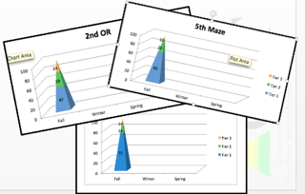
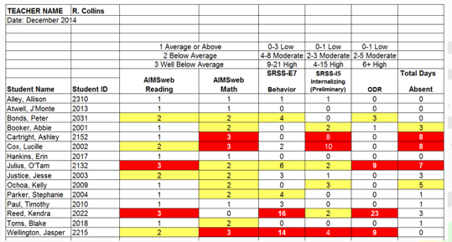
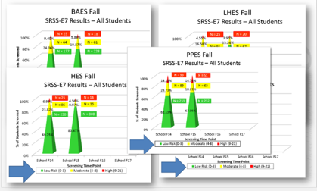
Communication:
Soliciting Feedback, Sharing Progress, Providing Professional Learning
Social Validity
Treatment Integrity
Systematic Screening
Academic
Behavior

Slide 14
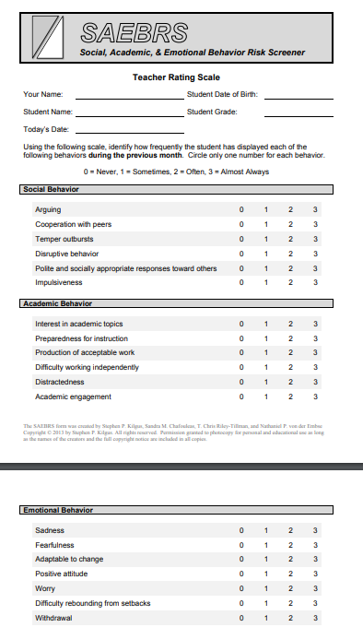

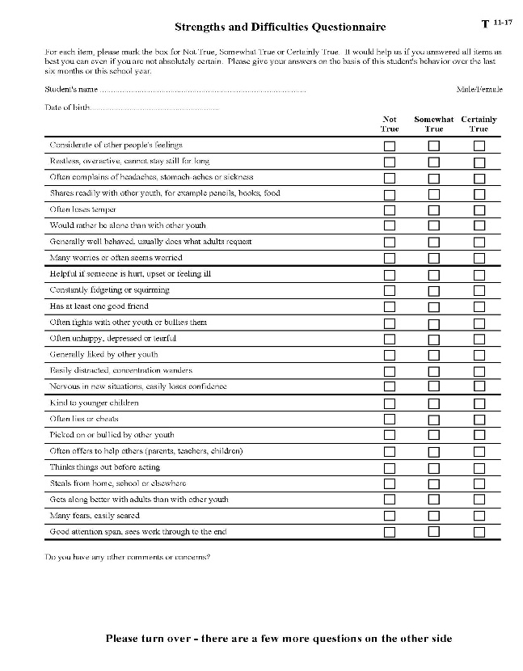
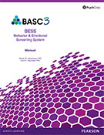
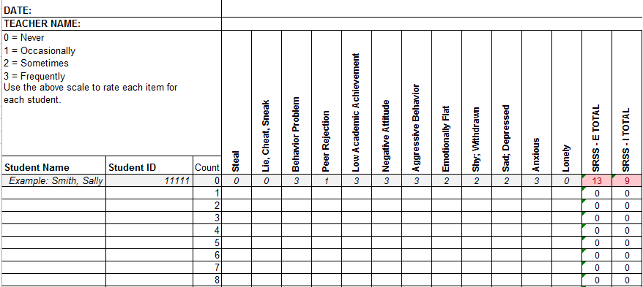
What screening tools are available?
See Lane, Menzies, Oakes, and Kalberg (2012)

Slide 15

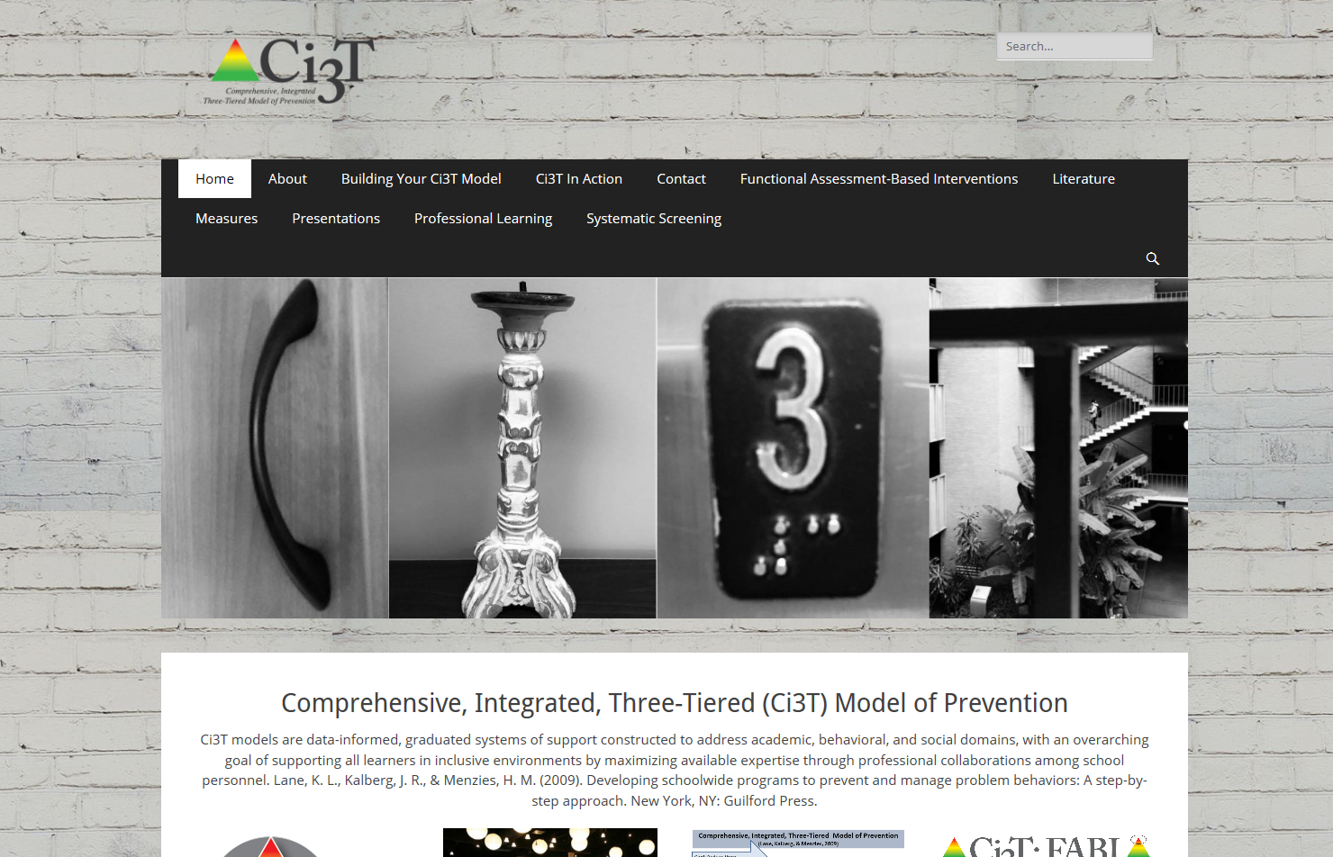
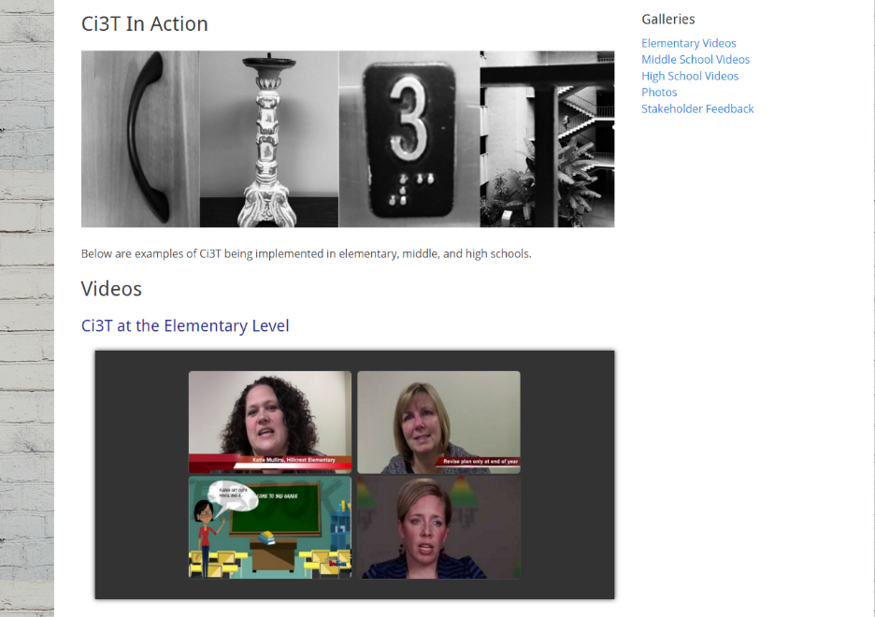
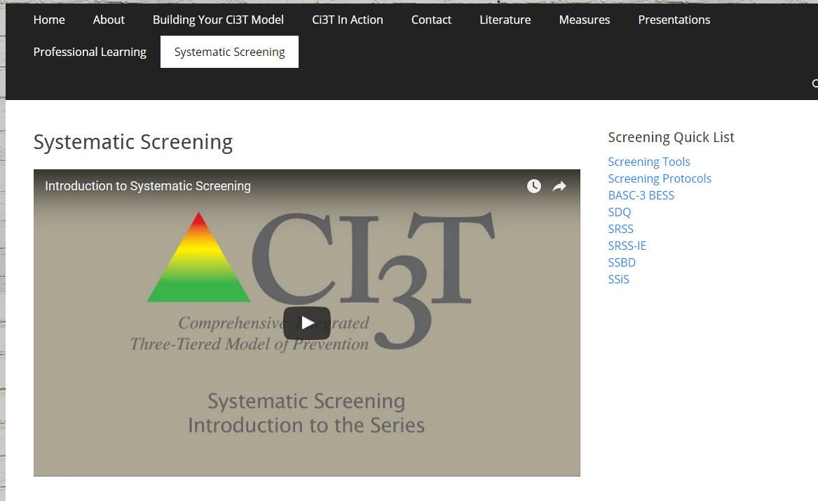
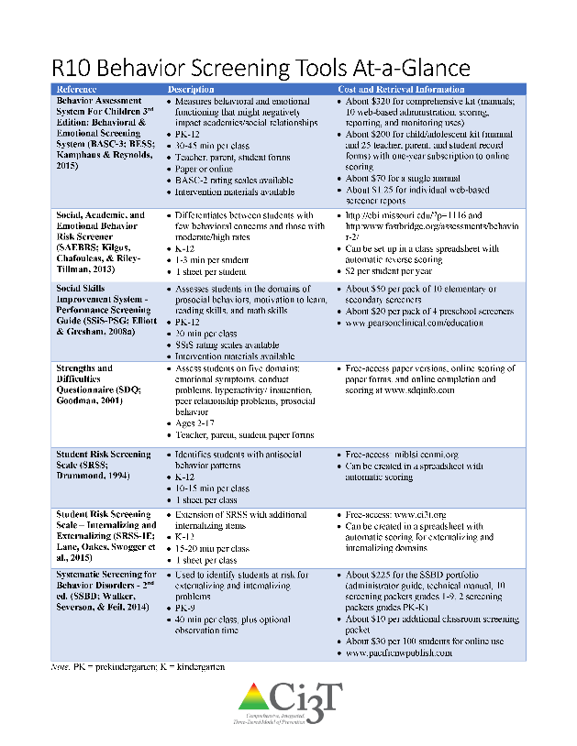

CI3T.org
www.ci3t.org
Systematic Screening

Slide 16
Considerations
Psychometrically Sound
Socially Valid
If social validity is lacking, even psychometrically strong tools are likely to remain unused by educators.

Slide 17

Systematic Screener for Behavior Disorders
Available from
Pacific Northwest Publishing
(SSBD 2nd ed.; Walker, Severson, & Feil, 2014)
Notes:
https://pacificnwpublish.com/products/SSBD-Online.html

Slide 18
SSBD Results
A rec
SSBD Results – Winter 2007 through Winter 2009
Risk Status of Nominated Students
Externalizing
% computed based on total # students screened
6.18%
3.50%
3.18%
8.90%
6.50%
2.73%
1.44%
Source. Lane, Menzies, Oakes, & Kalberg, 2012. Figure 2.2 WES Elementary Systematic Screening for Behavior Disorders (SSBD; Walker & Severson, 1992) results comparing the percentage of students nominated and exceeding normative criteria for both externalizing and internalizing behavior disorders over a three year period.
Notes:
18

Slide 19
Student Risk Screening Scale for Internalizing and Externalizing
Available on ci3t.org
(SRSS-IE; Drummond, 1994 and Lane & Menzies, 2009)

Slide 20
Student Risk Screening Scale-IE
12 items scale for use at the elementary, middle, and high schools
Subscale scores used for interpretation.
No total scale score.

Slide 21
SRSS-IE: Cut Scores
Enter ‘practice’ data into that one sheet so that the total scores and conditional formatting are tested.
Confirm the “Count” column is completed (students’ numbered sequentially). Formulas are anchored by the “Count” column; it must contain a number for each student listed for accurate total formulas.
Elementary School |  | Middle and High School
SRSS-E7 | SRSS-I5 | SRSS-E7 | SRSS-I6
Items 1-7 | Items 8-12 | Items 1-7 | Items 4, 8-12
0-3 = low risk 4-8 = moderate risk 9-21 = high risk | 0-1 = low risk 2-3 = moderate risk 4-15 = high risk | 0-3 = low risk 4-8 = moderate risk 9-21 = high risk | 0-3 = low risk 4-5 = moderate risk 6-18 = high risk
Elementary School Level:
Lane, K. L., Oakes, W. P., Swogger, E. D., Schatschneider, C., Menzies, H., M., & Sanchez, J. (2015). Student risk screening scale for internalizing and externalizing behaviors: Preliminary cut scores to support data-informed decision making. Behavioral Disorders, 40, 159-170.
Middle and High School Levels:
Lane, K. L., Oakes, W. P., Cantwell, E. D., Schatschneider, C., Menzies, H., Crittenden, M., & Messenger, M. (in press). Student Risk Screening Scale for Internalizing and Externalizing Behaviors: Preliminary cut scores to support data-informed decision making in middle and high schools. Behavioral Disorders.

Slide 22
Sample elementary school fall
Sample Elementary School Fall (Externalizing)
SRSS-E7 Results – All Students
N = 34
N = 29
N = 20
N = 99
N = 78
N = 56
N = 371
N = 407
N = 358

Slide 23
Sample Elementary school: Fall (internalizing)
Sample Elementary School: Fall (Internalizing)
SRSS-I5 Results – All Students
N = 55
N = 46
N = 35
N = 90
N = 77
N = 64
N = 359
N = 391
N = 335

Slide 24
Examining your screening data …
… implications for Tier 1 practices
… implications for teacher-delivered strategies
… implications for Tier 2 and Tier 3 supports
See Lane, Menzies, Bruhn, and Crnobori (2011)

Slide 25
Social Skills Improvement System – Performance Screening Guide
Spring 2012 – Total School
N = 54
N = 22
N = 35
N = 31
N = 223
N = 233
N = 180
N = 187
N = 212
N = 235
N = 275
N = 271
n = 489 n = 490 n = 490 n = 489
Lane, K. L., Oakes, W. P., & Magill, L. (2013). Primary prevention efforts: How do we implemented and monitor the Tier 1 component of our Comprehensive, Integrated, Three-Tiered (CI3T) Model?

Slide 26
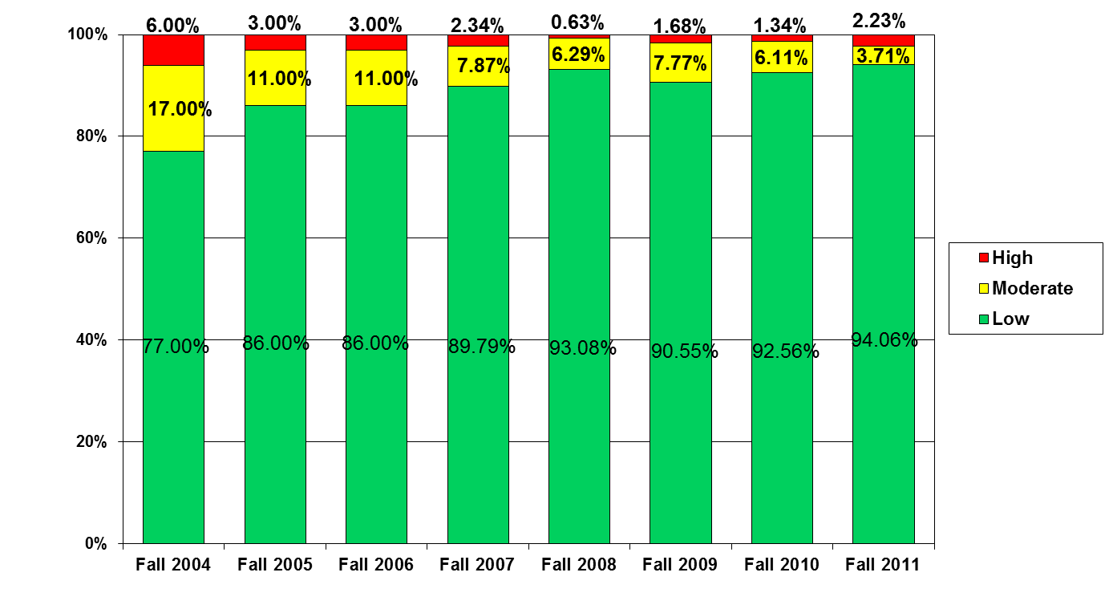
Student Risk Screening Scale
Middle School Fall 2004 - Fall 2011
n = 12
n = 20
n = 507
Percentage of Students
N=534
N=502
N=454
N=470
N=477
N=476
N=524
N= 539
Fall Screeners

Slide 27
Examining your screening data …
… implications for Tier 1 practices
… implications for teacher-delivered strategies
… implications for Tier 2 and Tier 3 supports
See Lane, Menzies, Bruhn, and Crnobori (2011)

Slide 28
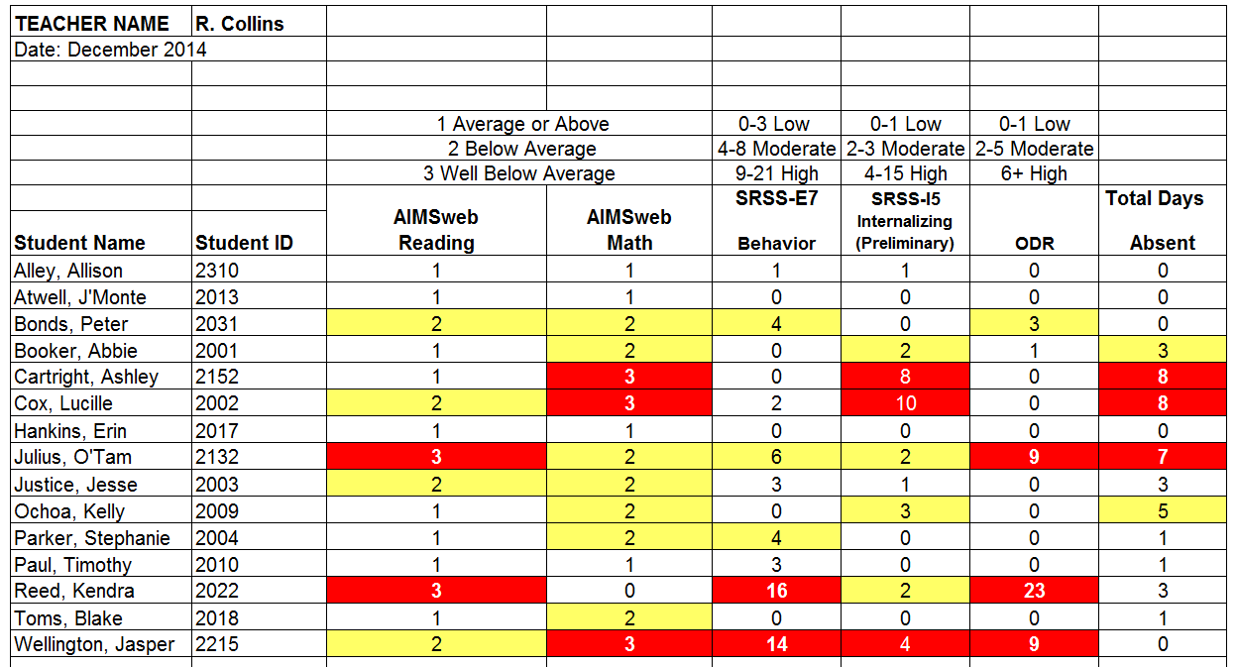
Examining Academic and Behavioral Data:
Elementary School Level
Examining Academic and Behavioral Data:
Elementary School Level
Lane, K. L., Menzies, H. M., Ennis, R. P., & Oakes, W. P. (2015). Supporting Behavior for School Success: A Step-by-Step Guide to Key Strategies. New York, NY: Guilford Press.
Notes:
Lane, K. L., Oakes, W. P., Ennis, R. P., & Hirsch, S. E. (2014). Identifying students for secondary and tertiary prevention efforts: How do we determine which students have Tier 2 and Tier 3 needs? Preventing School Failure, 58, 171-182, DOI: 10.1080/1045988X.2014.895573

Slide 29

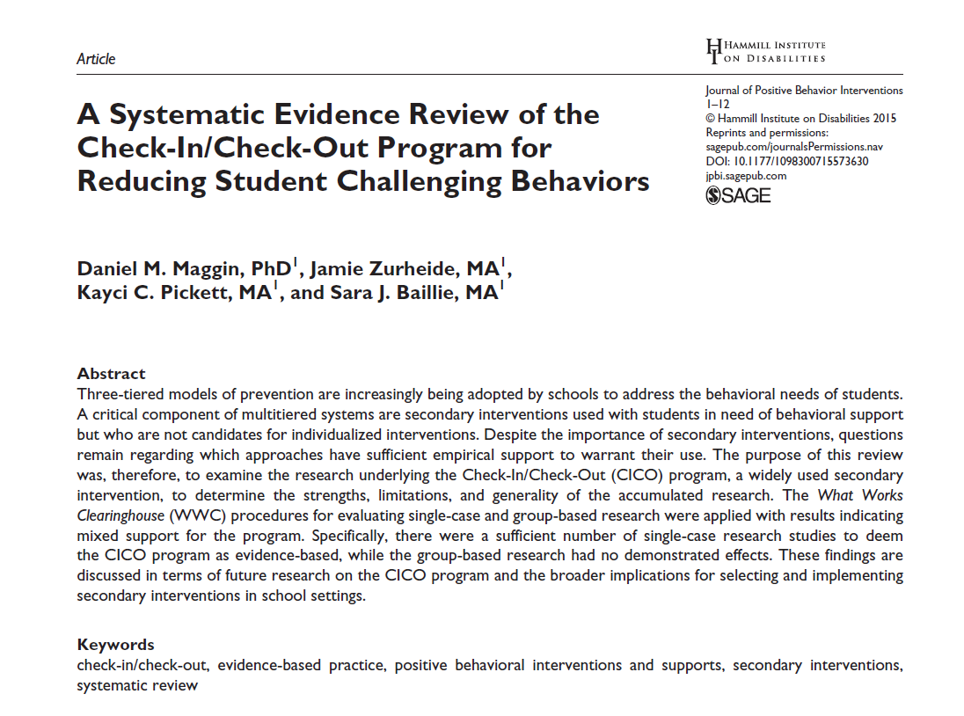



Low-intensity strategies
Low-Intensity Strategies
Opportunities to Respond
Behavior Specific Praise
Active Supervision
Instructional Feedback
High p Requests
Precorrection
Incorporating Choice
Self-monitoring
Behavior Contracts
Notes:
Lane, K. L., Oakes, W. P., Ennis, R. P., & Hirsch, S. E. (2014). Identifying students for secondary and tertiary prevention efforts: How do we determine which students have Tier 2 and Tier 3 needs? Preventing School Failure, 58, 171-182, DOI: 10.1080/1045988X.2014.895573

Slide 30
Examining your screening data …
… implications for Tier 1 practices
… implications for teacher-delivered strategies
… implications for Tier 2 and Tier 3 supports
See Lane, Menzies, Bruhn, and Crnobori (2011)

Slide 31
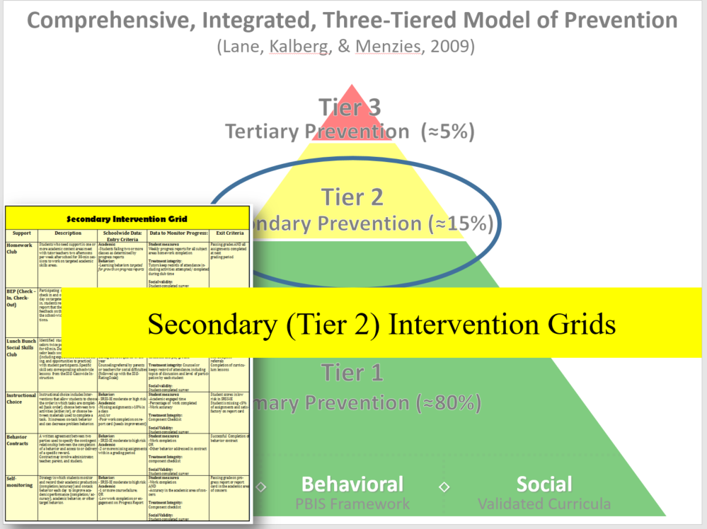
Tier 2 intervention grids

Slide 32
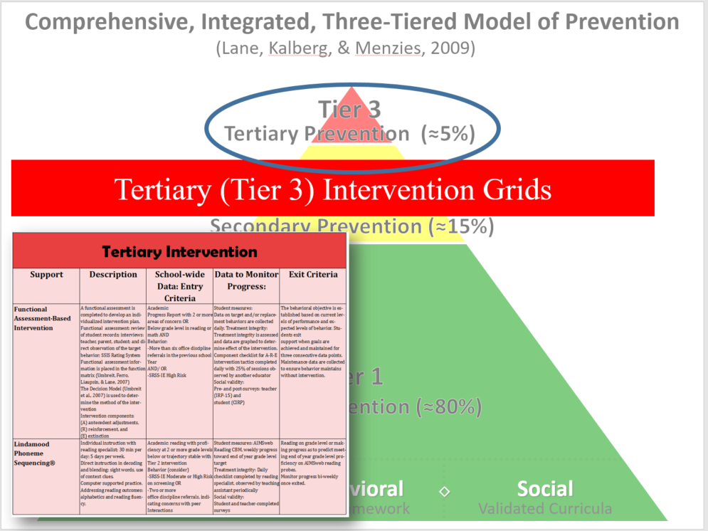
Tier 3 Intervention grids

Slide 33
SAMPLE TERTIARY (Tier 3) INTERVENTION GRID
Support | Description | Schoolwide Data: Entry Criteria | Data to Monitor Progress | Exit Criteria
Functional Assessment-Based Intervention | Individualized interventions developed by the behavior specialist and PBS team | Students who: Behavior -scored in the high risk category on the Student Risk Screening Scale (SRSS), or scored in the clinical range on one following Strengths and Difficulties (SDQ) subscales: Emotional Symptoms, Conduct Problems, Hyperactivity, or Prosocial Behavior, -earned more than 5 office discipline referrals (ODR) for major events during a grading period OR Academic identified at highest risk for school failure: recommended for retention; or scored far below basic on state-wide or district-wide assessments | Data will be collected on both the (a) target (problem) behavior and (b) replacement (desirable) behavior identified by the team on an on-going basis. Weekly teacher report on academic status ODR data collected weekly Treatment Integrity Social Validity | The function-based intervention will be faded once a functional relation is demonstrated using a validated single case methodology design (e.g., withdrawal design) and the behavioral objectives specified in the plan are met.
See ci3t.org/pl for other illustrations
State of Tennessee DOE Technical Assistance Grant IRB # 090935

Slide 34
Share!

Slide 35
NCII’s Behavior Screening Tools Chart

Slide 36
National Center on Intensive Intervention
“Our mission is to build capacity of state and local educational agencies, universities, practitioners, and other stakeholders to support implementation of intensive intervention in reading, mathematics, and behavior for students with severe and persistent learning and/or behavioral needs.”

Slide 37

What is Intensive Intervention?
Intensive intervention addresses severe and persistent learning or behavioral difficulties.
Driven by data
Characterized by increased intensity and individualization

Slide 38
What is NCII’s Approach to Intensive Intervention?
Data-Based Individualization (DBI):
Has its origins in experimental teaching
Is a process
Is not a one-time fix
Integrates data-based decision making across academics and social behavior

Slide 39
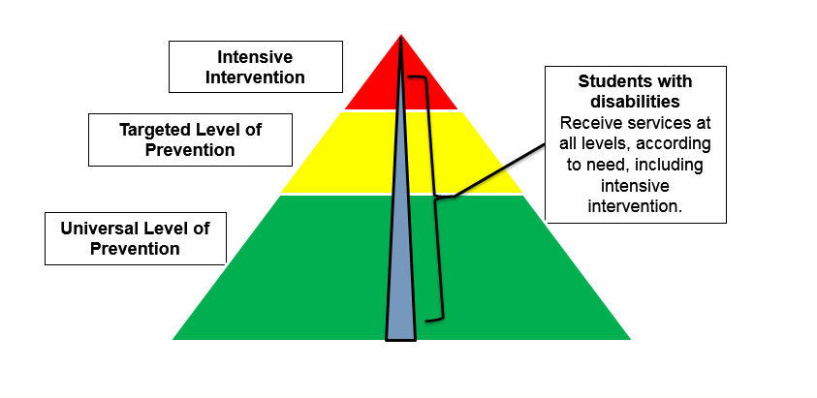
Multi-tiered Systems of Support (MTSS)

Slide 40
What does screening have to do with intensive intervention?
  Comprehensive nature of assessment packages
  Guidance on assessment for implementation of full MTSS framework
  Fast-track screening

Slide 41



History of Tools Charts
2004-07
2008-11
2012-16
2016-20
1. Academic Progress Monitoring
2. Academic Screening
3. Academic Intervention
4. Behavior Progress Monitoring
5. Behavior Intervention
6. Behavior Screening

Slide 42
About the Tools Charts
Tools charts display expert ratings on the technical rigor of assessments and interventions.
Products are reviewed by an external Technical Review Committee of experts.
Products are rated against established criteria and not compared to each other or ranked.
Charts are updated annually during a call for submissions. The submission process is voluntary and reviews of all eligible submissions are posted on the chart.
Don’t see a tool you use? Encourage the vendor to submit during the next open call!

Slide 43

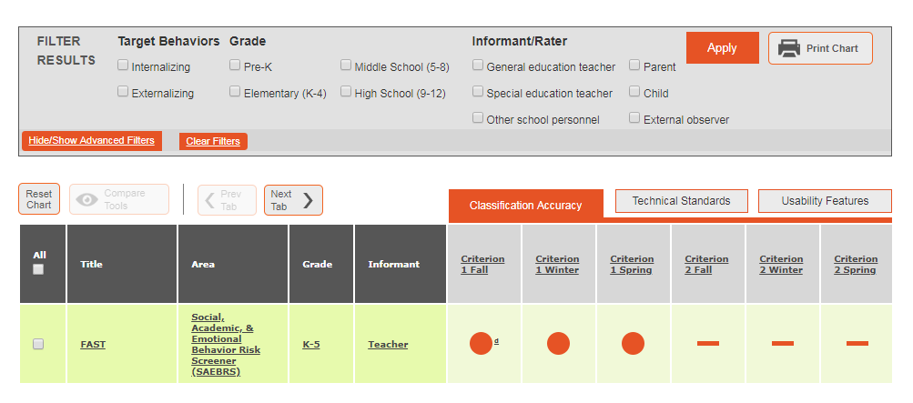
Spotlight on the Behavior Screening Tools Chart

Slide 44
NCII Definition of Screening…
…A process using tools with convincing evidence of classification accuracy, reliability, and validity to identify students who may require intensive intervention to meet their academic, social, emotional, and/or behavioral needs.

Slide 45
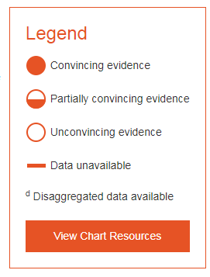
Tools Chart Structure & Review Criteria
The tools chart includes three tabs
  Classification Accuracy
  Technical Standards
  Usability Features

Slide 46
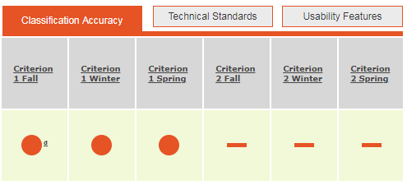
Classification Accuracy
How good is the tool at identifying who is or is not at risk (sensitivity/specificity)?
Ratings provided at 3 time points (Fall, Winter, Spring) for up to 2 criteria
Remember: Click on the header for more information about how each of these areas were rated.

Slide 47
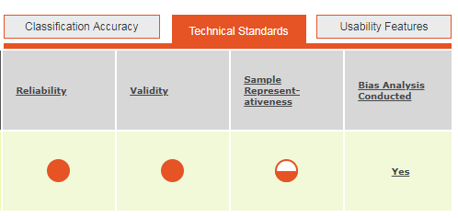
Technical Standards
Remember: Click on the tab to navigate from one tab to the next or use the next or previous tab buttons.
Reliability
Validity
Sample Representativeness
Bias Analysis Conducted

Slide 48
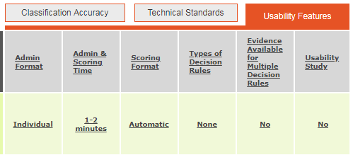
Usability Features
Administration Format
Administration & Scoring Time
Scoring Format
Types of Decision Rules
Evidence Available for Multiple Decision Rules
Usability Study

Slide 49
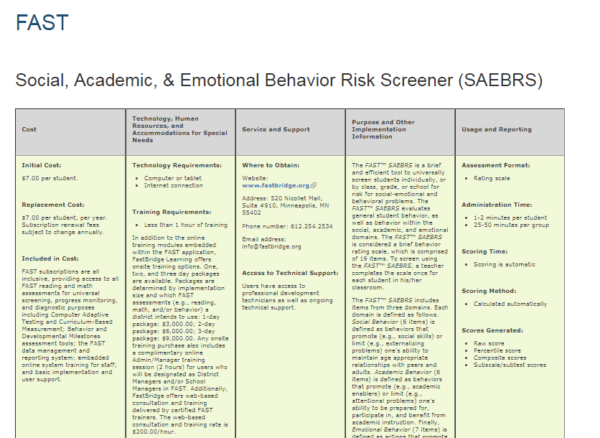
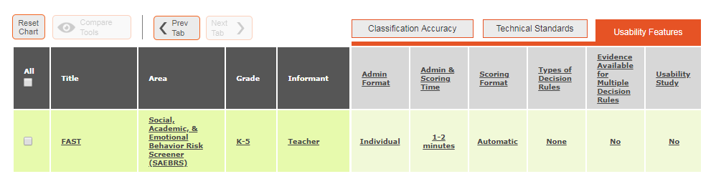
Implementation Information
For implementation information click on the title, area, grade or informant

Slide 50
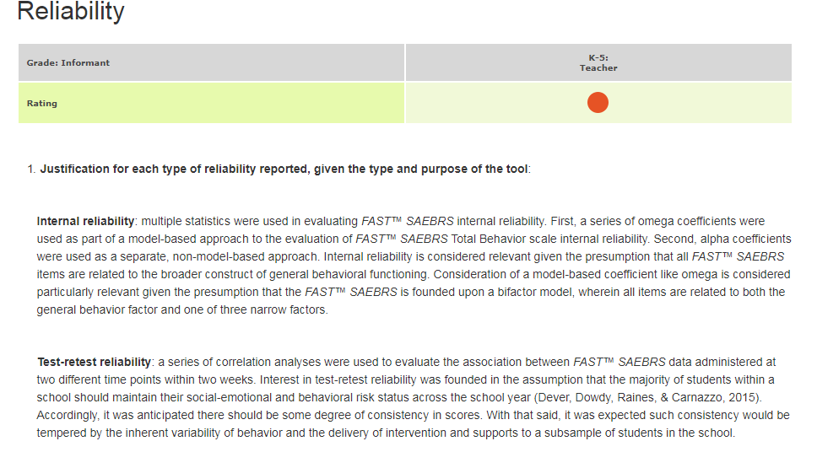
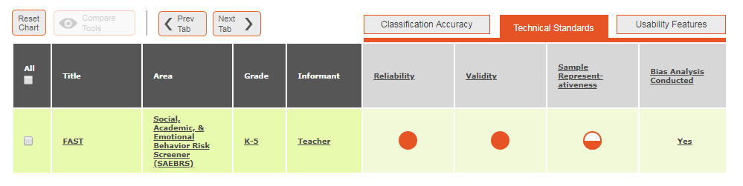
Dig Deeper Into the Data
Click on the rating bubble to view the data used by reviewers to determine the rating

Slide 51
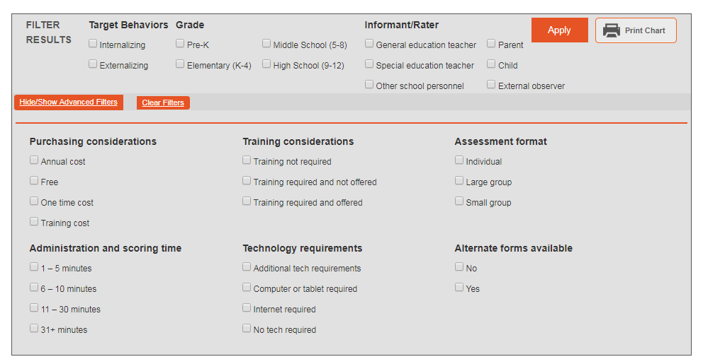
Advanced Filtering
Get a printable version of the chart
Looking for something specific? Use the advanced filtering to narrow your search

Slide 52
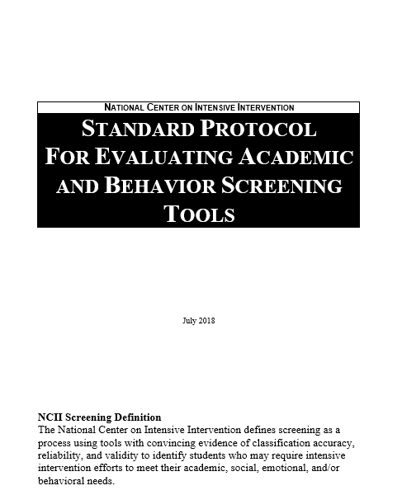
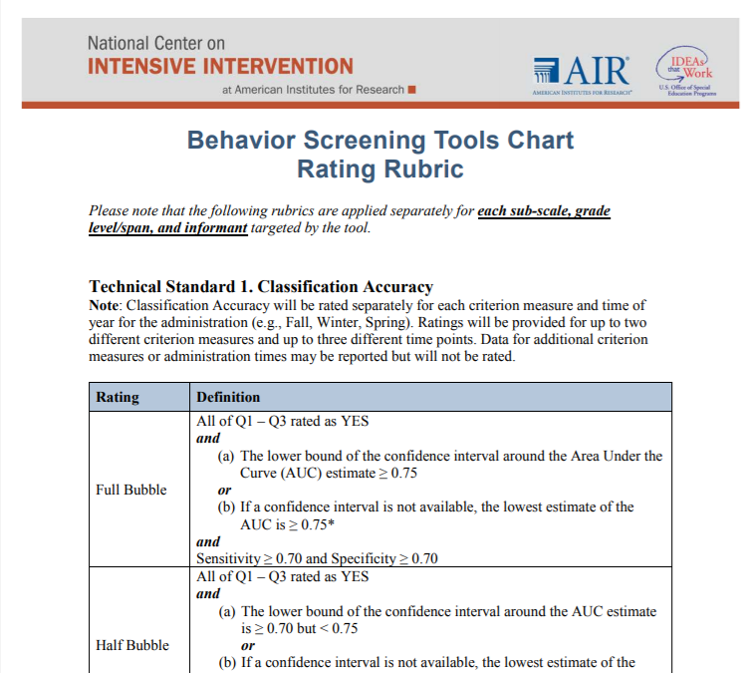
Call for Behavior Screening Tools Now Open
The Academic and Behavior Screening TRC’s have a call for screening tools open until September 25, 2018.
Learn more: https://intensiveintervention.org/about-charts-review-process

Slide 53
Other Tools Charts
Academic Screening https://charts.intensiveintervention.org/chart/academic-screening
Academic Progress Monitoring https://charts.intensiveintervention.org/chart/progress-monitoring
Behavior Progress Monitoring https://charts.intensiveintervention.org/chart/behavioral-progress-monitoring-tools
Academic Intervention https://charts.intensiveintervention.org/chart/instructional-intervention-tools
Behavior Intervention https://charts.intensiveintervention.org/chart/behavioral-intervention-chart

Slide 54
Questions

Slide 55
Closing Slide

Slide 56
NCII Disclaimer
This presentation was produced under the U.S. Department of Education, Office of Special Education Programs, Award No. H326Q160001. Celia Rosenquist serves as the project officer. The views expressed herein do not necessarily represent the positions or policies of the U.S. Department of Education. No official endorsement by the U.S. Department of Education of any product, commodity, service, or enterprise mentioned in this website is intended or should be inferred.

